Slide 1




Cook it yourself

Slide 2



agenda
Weekly progress
Next steps
project progress

Slide 3
Weekly progress
CI/CD base implementation
Feedback received, started to work on them

Slide 4

Next steps
Find solution for iPhone compatibility
CI/CD knowledge sharing
Expecting more feedback

Slide 5
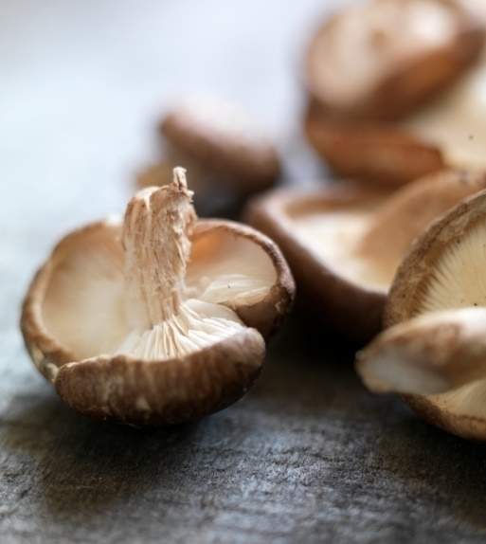
project progress

Slide 6
Thank you

